Slide 1
Data Structures CS2002
Search Algorithms, Binary Search Trees

Slide 2
Sequential Search
(Unsorted list, recursive)
ITEM searchR(Node t, KEY findkey)
{
if (t == null ) return null;
if ((t.item.key) == findkey ) return t.item;
return searchR(t.next, findkey);
}

Slide 3
Analysis
Sequential search takes linear time : O(n)
Sequential Search is appropriate for small lists
Keep frequently accessed records in the front end
If the list is sorted then you can stop the search earlier.

Slide 4
Binary Search
(Sorted list, recursive)
ITEM searchR(int left, int right, KEY find)
{
if(left > right) return null;
int mid = (left + right)/2;
if (find == arr[mid].key()) return arr[mid];
if ( find < arr[mid].key())
return searchR(left, mid –1, find);
else
return searchR(mid +1, right, find);
}
Analysis: Both successful and unsuccessful binary search needs O(logn) comparisons.

Slide 5
Binary Search Trees
Ref: Section 5.7 Data Structures in C++
Why are binary search trees needed?
Definition of binary search tree:
  Every element has a unique key
  The keys in a nonempty left subtree (right subtree) are smaller (larger) than the key in the root of subtree
  The left and right subtrees are also binary search trees

Slide 6
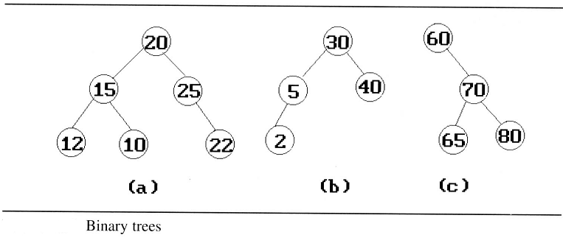
Example: (b) and (c) are binary search trees
medium
smaller
larger

Slide 7
Binary Search Trees
Search:
Search(25)
Search(76)
44
17
88
32
65
97
28
54
82
29
76
80

Slide 8
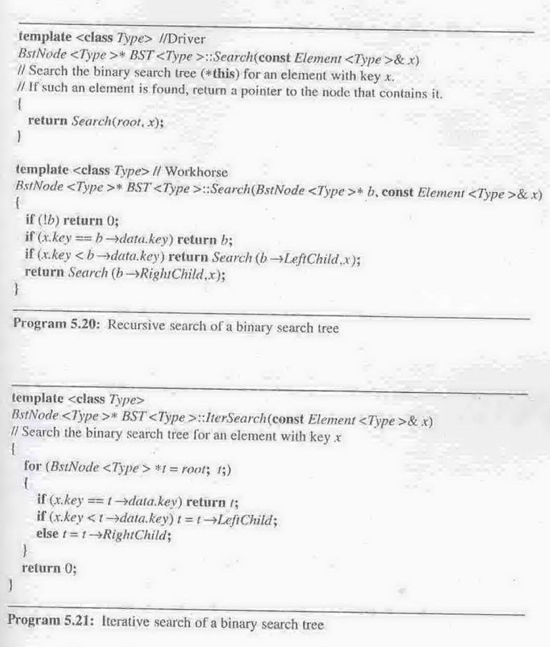
Searching a
binary search
tree

Slide 9
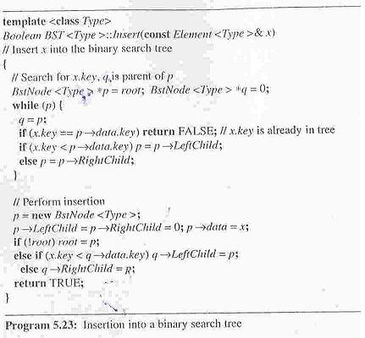
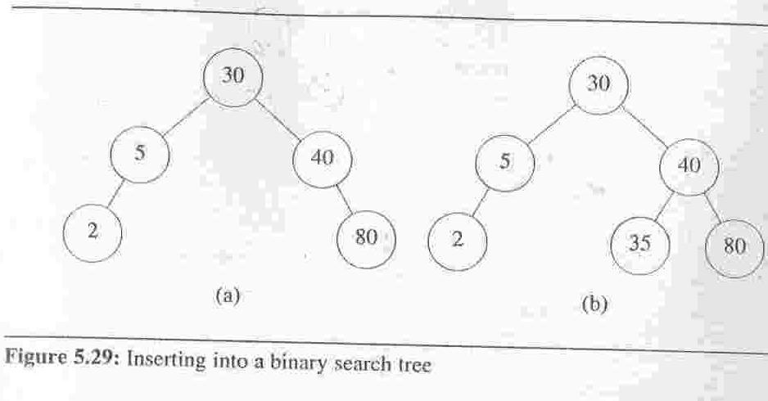
Insertion into a Binary Search Tree

Slide 10
Example:
Create a Binary Search Tree with the following input sequence and then show the steps to find 16 in the tree
12 4 9 2 14 16 13 18 1

Slide 11
Deletion from a Binary Search Tree
  Three cases should be considered
  Case 1: leaf → delete
  Case 2: one child → delete and change the pointer to this child
  Case 3: two child → either the smallest element in the right subtree or the largest element in the left subtree

Slide 12
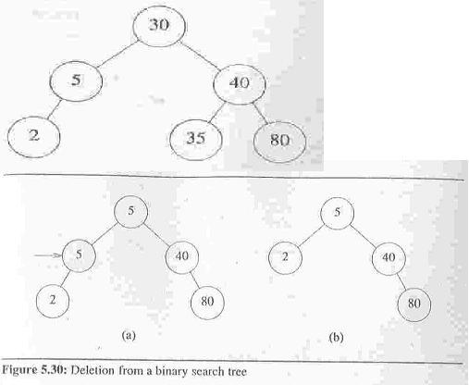

Slide 13
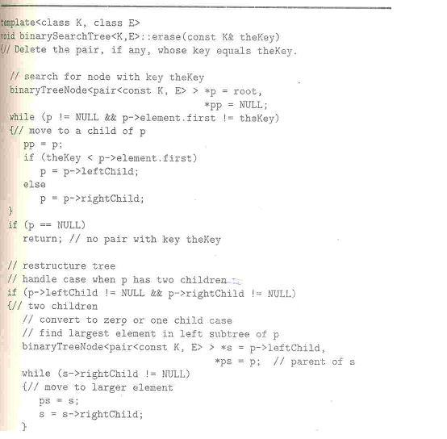
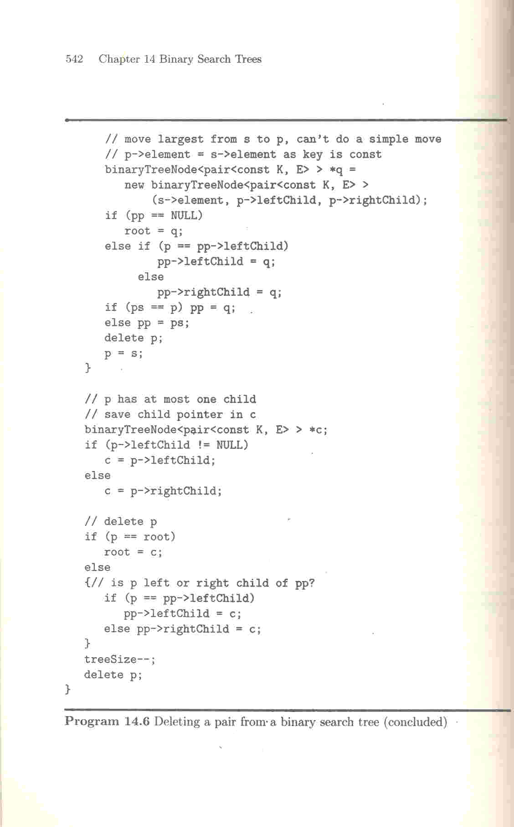
Taken from “Data Structures and Algorithms and Applications in C++” by Sartaj Sahni

Slide 14
Height of a binary search tree
  The height of a binary search tree with n elements can become as large as n.
  It can be shown that when insertions and deletions are made at random, the height of the binary search tree is O(log₂n) on the average.
  Search trees with a worst-case height of O(log₂n) are called balance search trees
Time Complexity
  Searching, insertion, removal
    O(h), where h is the height of the tree
  Worst case - skewed binary tree
    O(n), where n is the # of internal nodes
Prevent worst case
  rebalancing scheme
  2-3, and Red-black tree

Slide 15
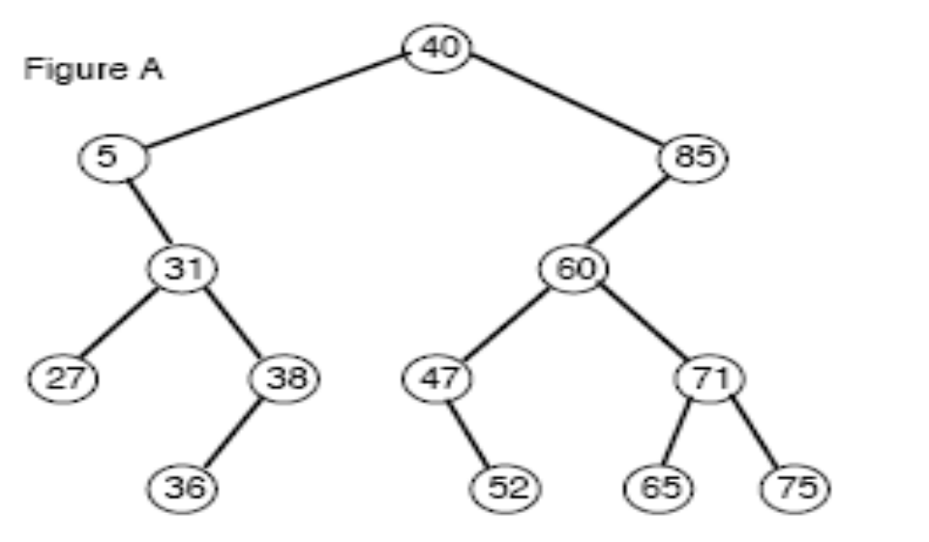
Homework
Draw the resulting Binary Search Tree after insertion of item with key 53 in the BST shown in the figure.
Remove the entry with key 40 from the binary search tree in the figure
3. Write a simple algorithm that would take an input number, NUM, and then return all items that are smaller than or equal to this number in a given Binary Search Tree. Make sure that your algorithm runs in O(n) time in the worst case where n is the total number of nodes in the tree

Slide 16
Homework
Add and implement the following function to binary tree ADT which would return true if the Binary tree is a BST and false otherwise.
bool BinaryTree<DT>::IsBST()

